Slide 1


Slide 2

ЗЕМЛЯ –
НАШ
ОБЩИЙ ДОМ

Slide 3
ТЕМА УРОКА:
«Мой чистый мир»
«My Pure World»

Slide 4

Пусть на Земле не умирают реки,
Пусть стороной обходит их беда.
Пусть чистой остается в них навеки
Студеная и вкусная вода.
В. Огнецвет

Slide 5
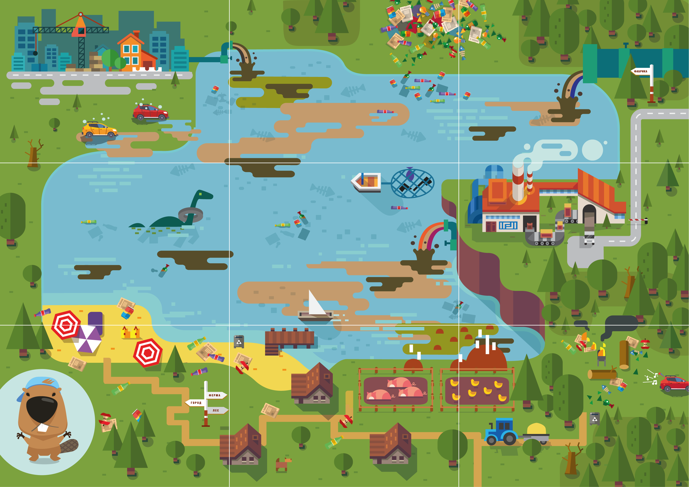
СПАСЕМ ЗАГРЯЗНЕННОЕ ОЗЕРО!
LET’S HELP THE DIRTY LAKE!

Slide 6

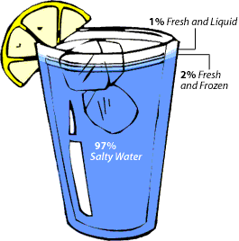
1. ЗАГАДКИ - RIDDLES

Slide 7
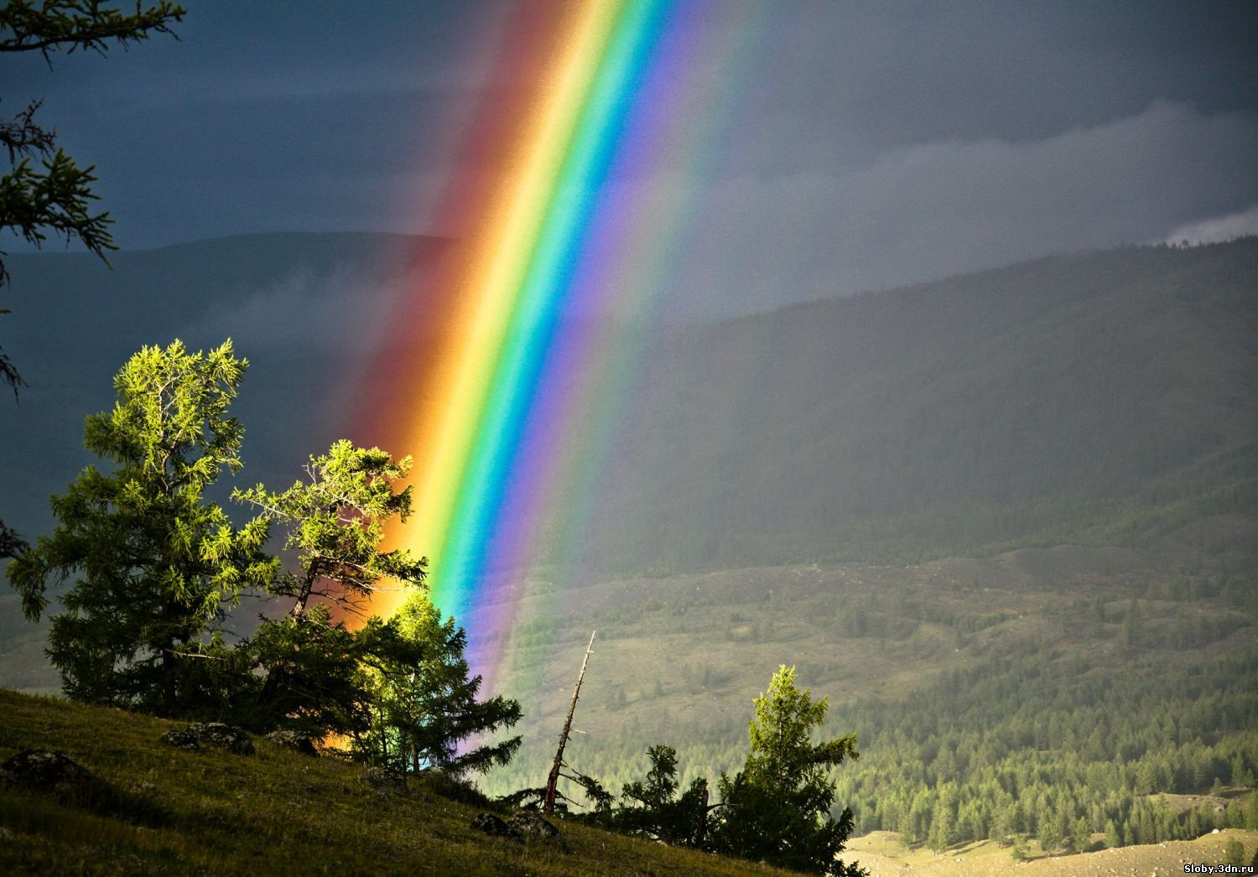

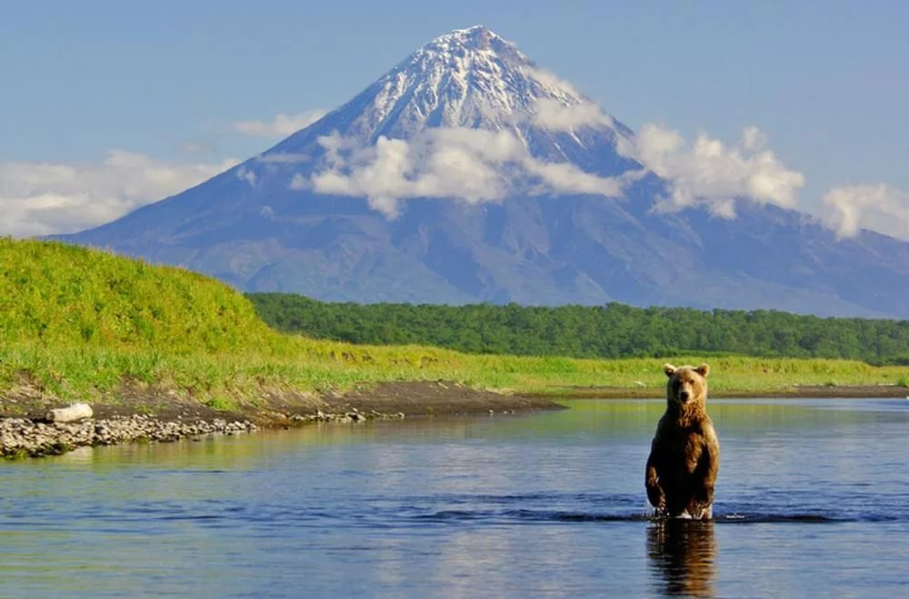
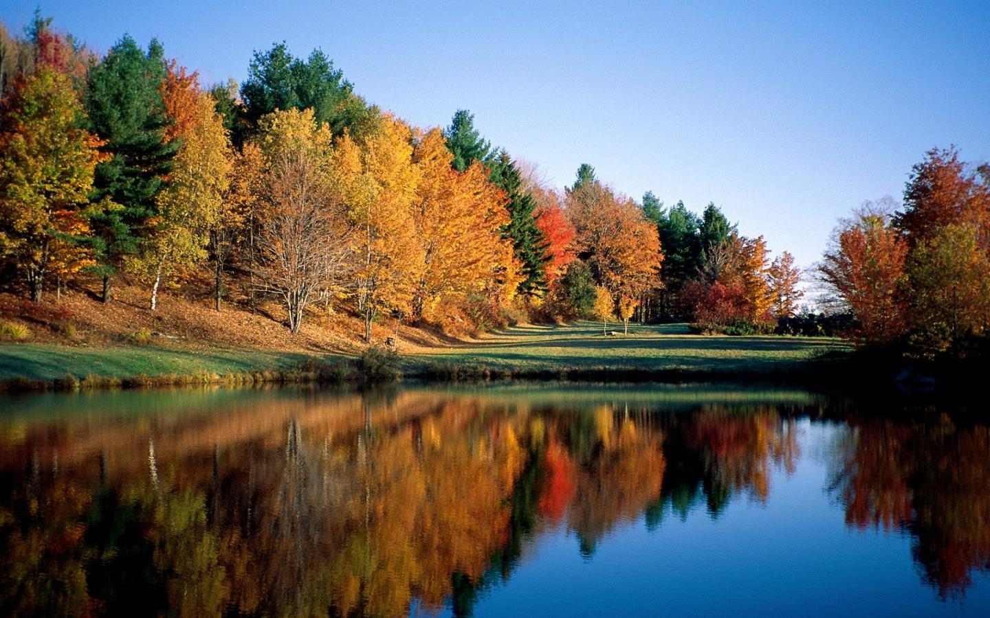
2. ЧТО Я МОГУ СОХРАНИТЬ?
WHAT CAN I SAVE?

Slide 8


3. «ТОПАЕМ – ХЛОПАЕМ»
DYNAMIC PAUSE

Slide 9

4. КРОССВОРД - CROSSWORD

Slide 10
МУСОРНОЕ
ПЯТНО В
ТИХОМ ОКЕАНЕ

Slide 11

5. СОРТИРОВКА МУСОРА - RECYCLING

Slide 12

6. «4 ЭЛЕМЕНТА»
«FOUR ELEMENTS»

Slide 13


7. КРИПТОГРАММА
CRYPTOGRAM

Slide 14


8. ЗАПРЕЩАЮЩИЕ ЗНАКИ В ПРИРОДЕ SIGNS ABOUT NATURE
You mustn’t…

Slide 15
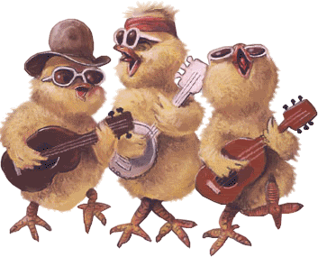
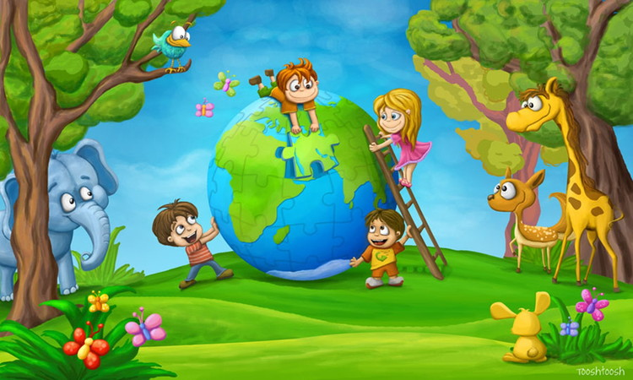
9. LET’S SING A SONG ABOUT NATURE!

Slide 16
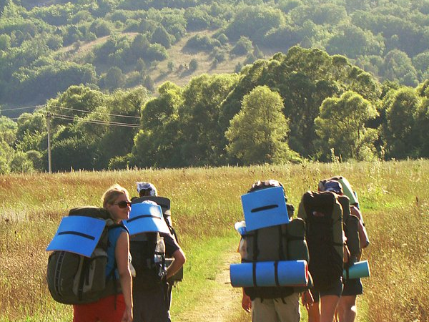
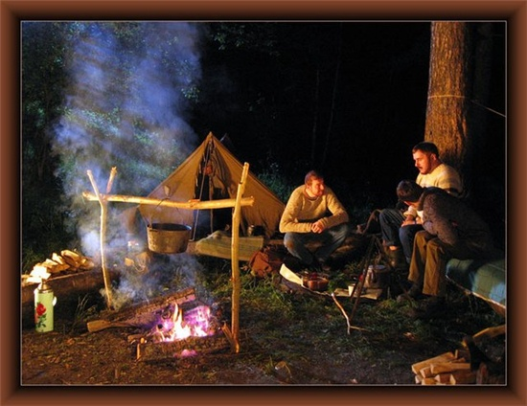

Today you are going camping
With your family, friends or class…

Slide 17
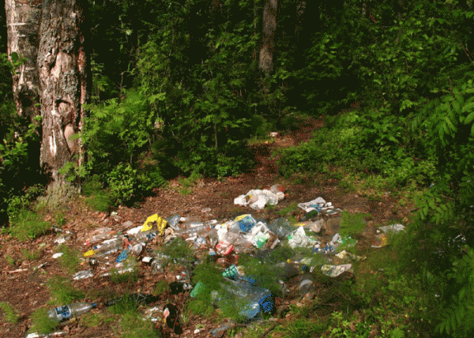
Please help us, don’t drop any litter!
‘Cos’ your litter lives longer than us.

Slide 18
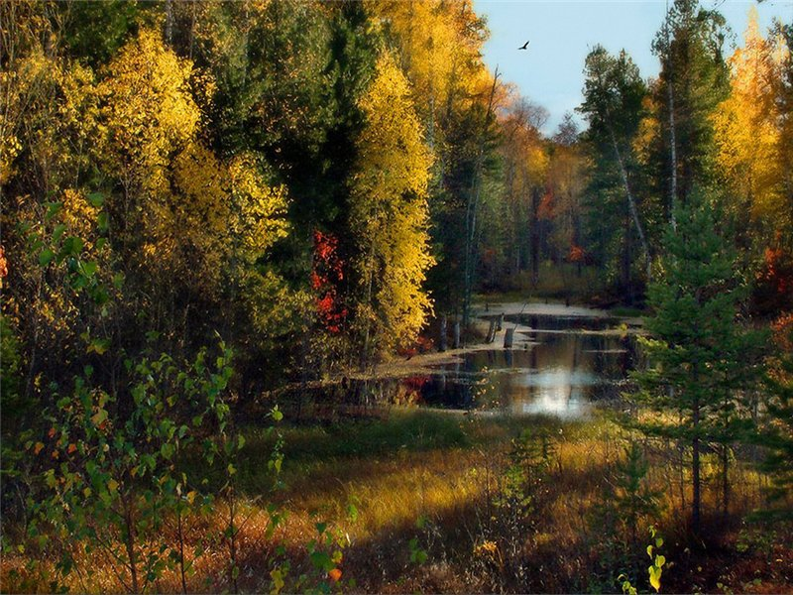
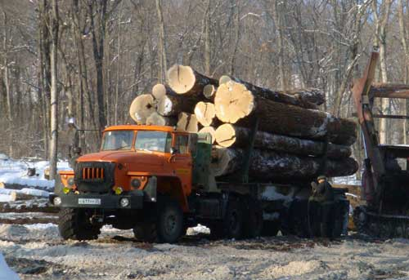
Today you cut down your forests
But the planet needs our leaves.

Slide 19
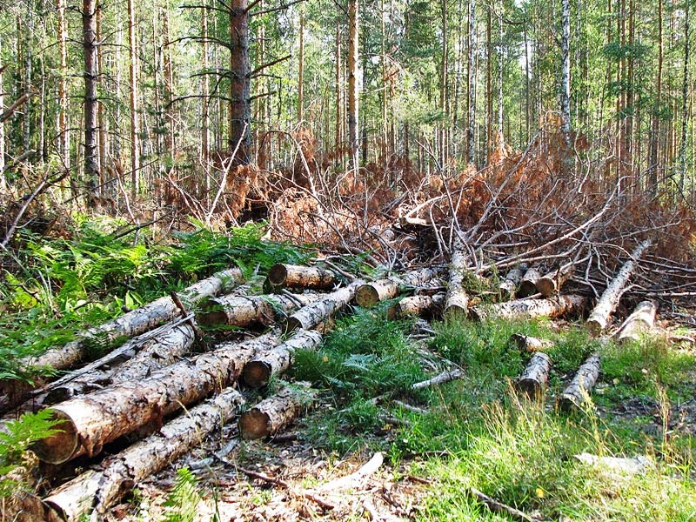
Please stop it because tomorrow
You will have no air to breathe!

Slide 20

'Cos nothing is forever
And nature is getting tired.
If we don't stop and think today…
Tomorrow the Earth could die.

Slide 21
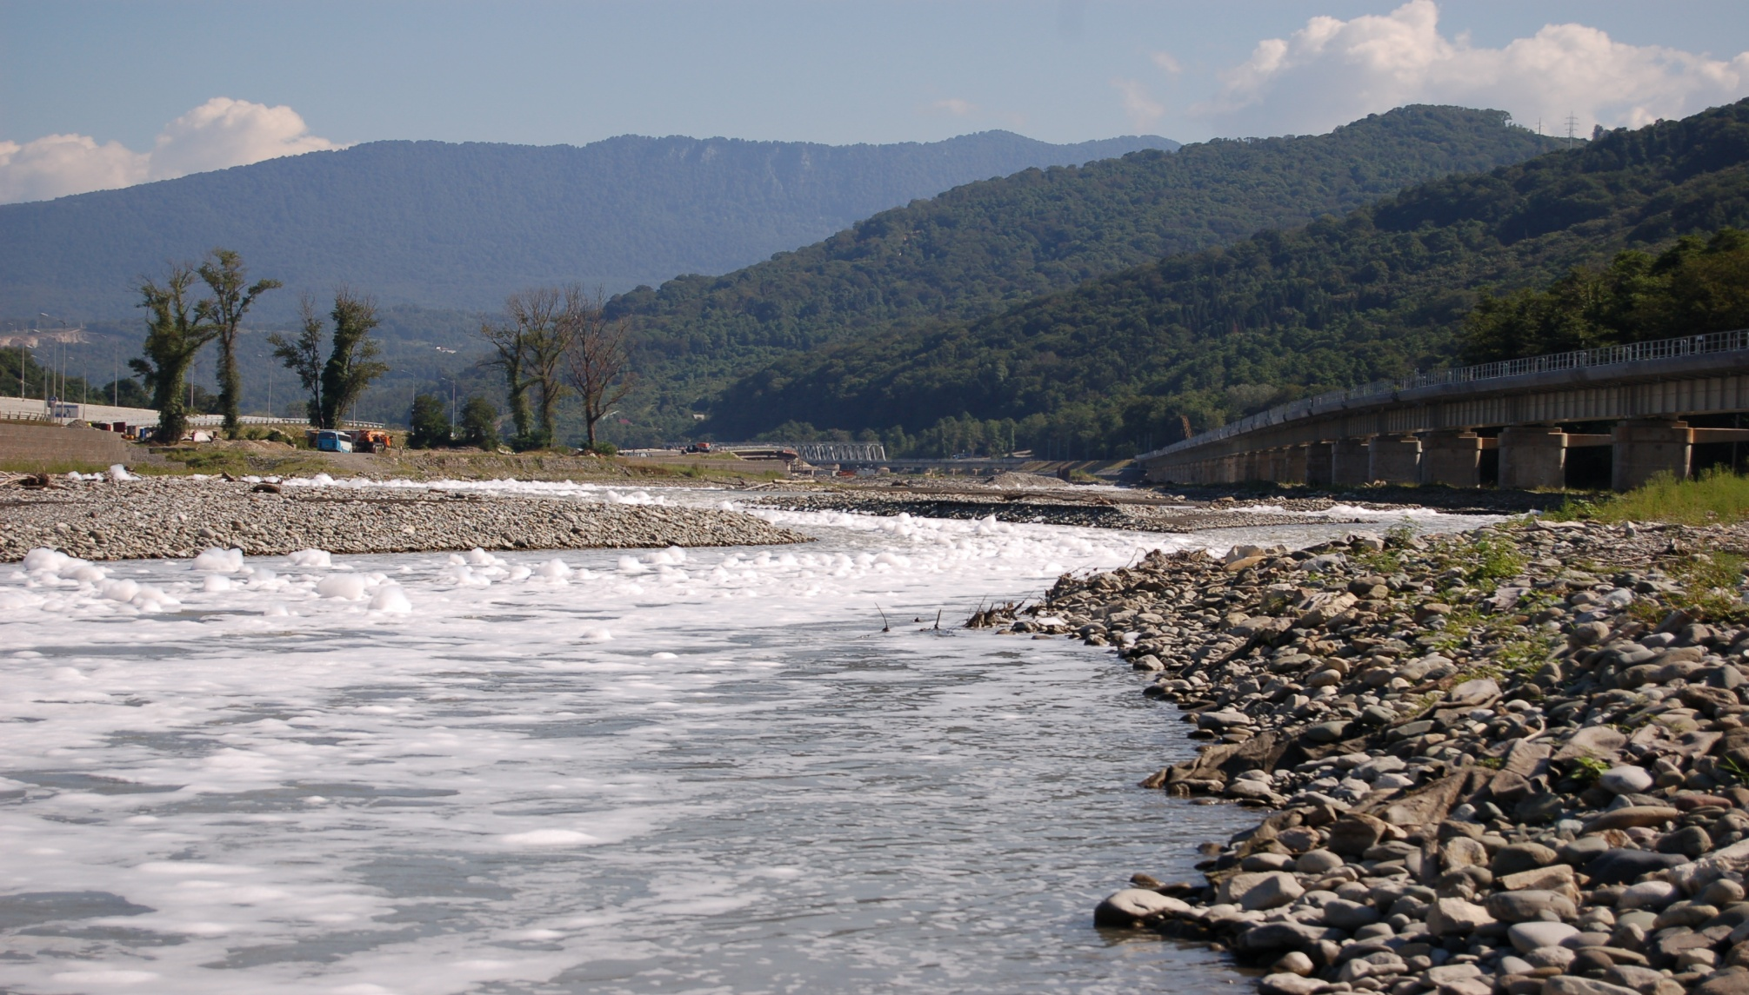
You can have a bath or a shower
But today is the time to think.

Slide 22
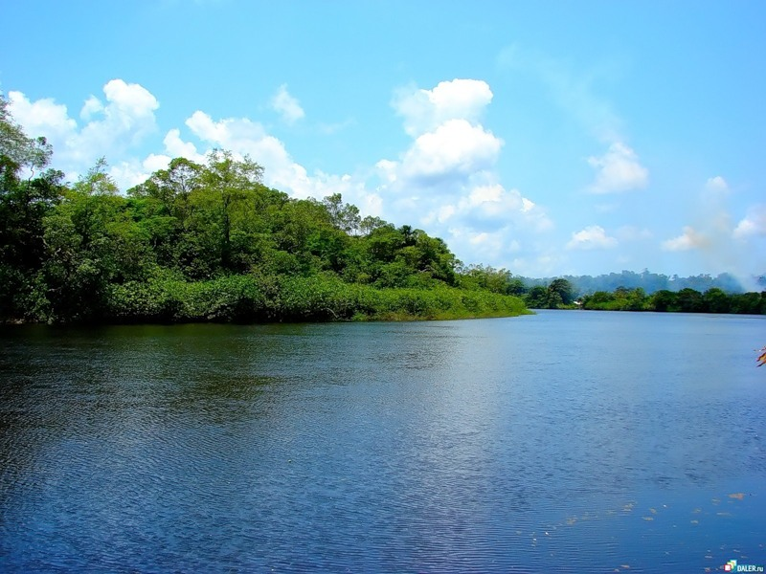
Save the rivers because without them
You'll have no water to drink.

Slide 23
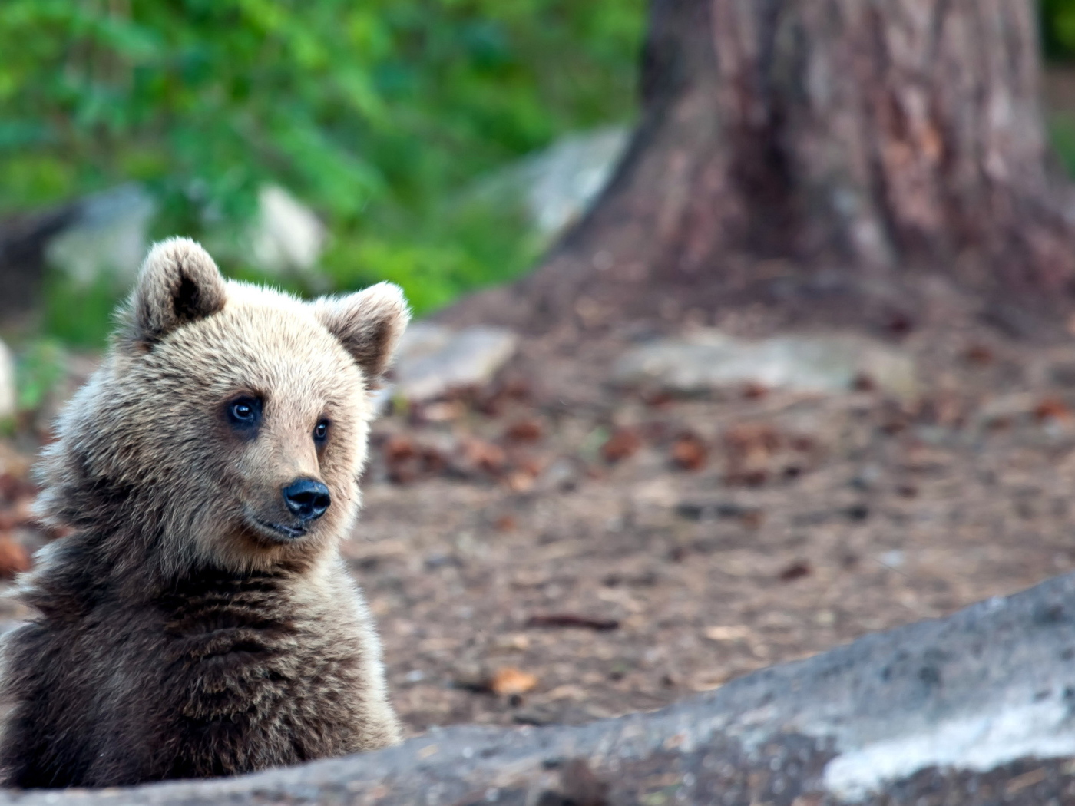
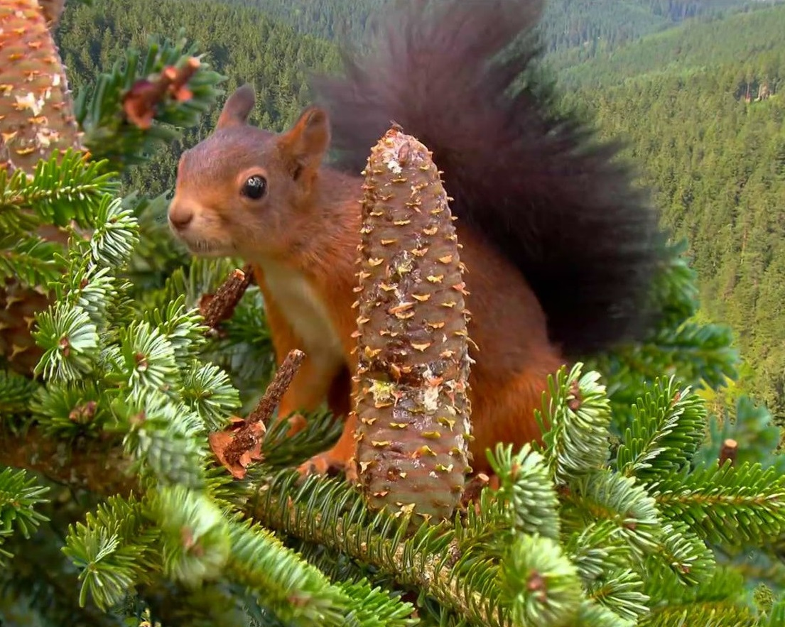
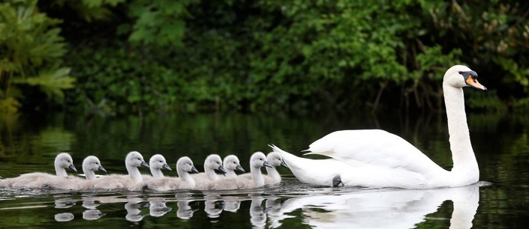
Today we are still in your forests,
In the sky, in the rivers, but look:

Slide 24

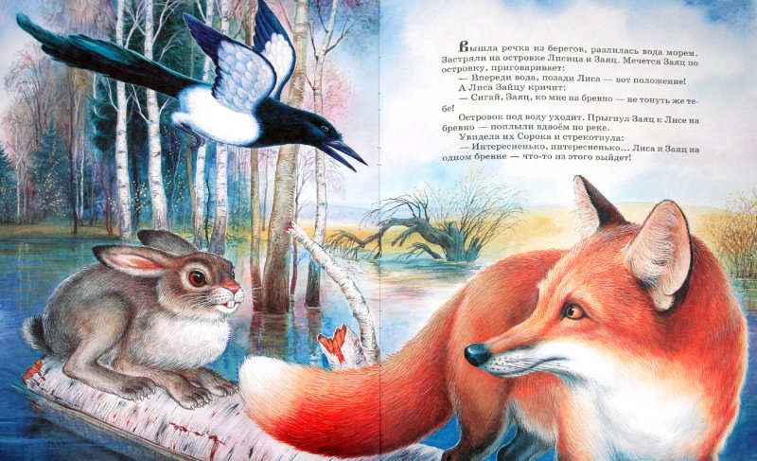
Don`t kill us, because your children will see us in picture books!

Slide 25
'Cos nothing is forever
And nature is getting tired.
If we don't stop and think today…
Tomorrow the Earth could die.

Slide 26
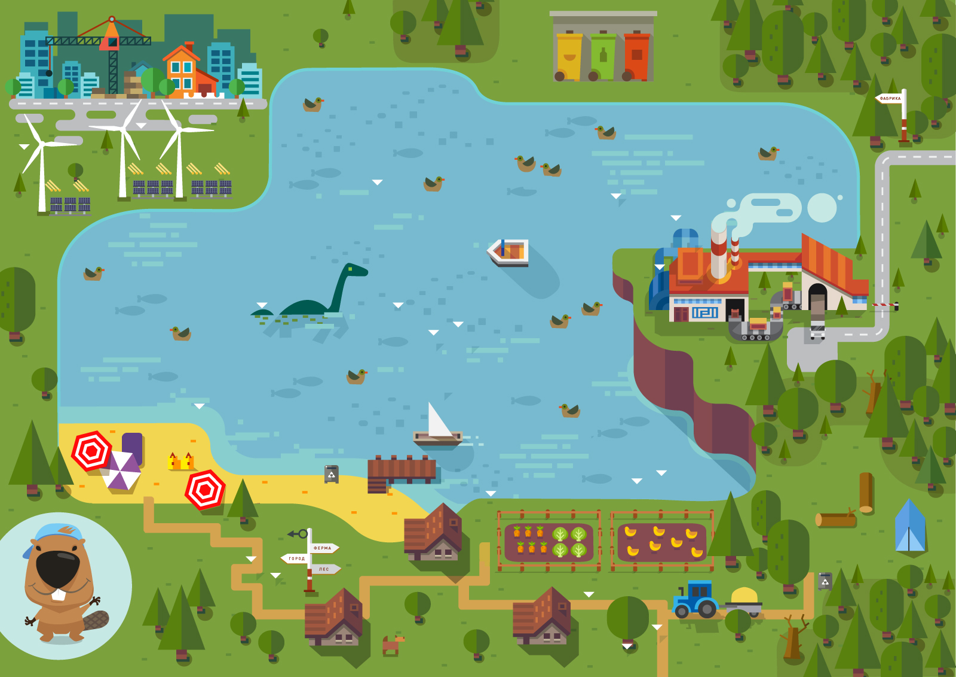
Вы справились!
Good for you!

Slide 27




